Slide 1
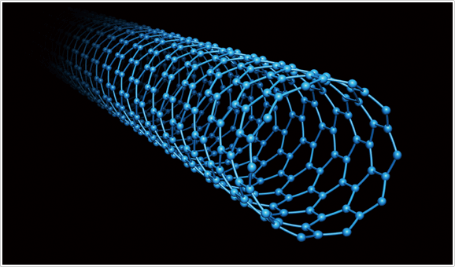
Carbon Nanotubes
The Material of The Future
Presenter: Andrew Crenwelge

Slide 2
Overview
What are carbon nanotubes?
Why are CNTs important materials?
Applications and Impact on Industry
Futuristic applications

Slide 3

What are carbon nanotubes?

Slide 4
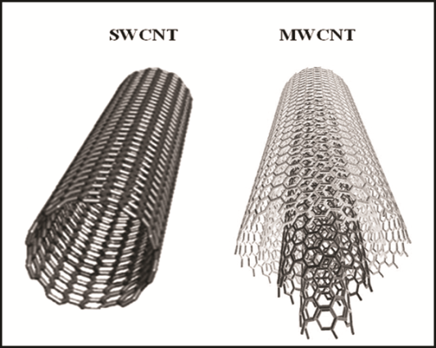
What Are Carbon Nanotubes (CNTs)?
Allotropes of carbon
Cylindrical arrangement of carbon sheet (graphene)
Categorized into single-walled carbon nanotubes (SWCNT) and multi-walled carbon nanotubes (MWCNT)
All bonds are sp² hybridized

Slide 5

Synthesis of Carbon Nanotubes (CNTs)
Synthesis Processes
Laser Ablation
Plasma torch
Chemical vapor
deposition (CVD)
Most widely used
Chemical Vapor Deposition

Slide 6
WHY ARE CNTs IMPORTANT?

Slide 7
Why are CNTs Important?
Incredible physical properties
Strength: Highest tensile strength and elastic modulus ever discovered with low density
Can with stand pressure of 50 GPa
Electrical: can be engineered to be conductor or semi-conductor
Theoretically, 1000x current density of Cu
Thermal conductors axially, but insulators laterally
Why? Strong sp²-hybridized bonds

Slide 8
Applications & Impact on INDUSTRY

Slide 9
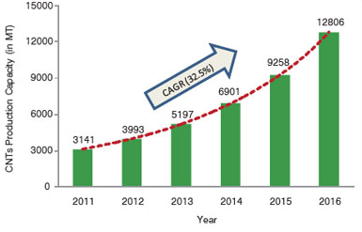
Market Demand

Slide 10

Projected Market Demand

Slide 11
Applications: Polymers
Current use of CNT
Bulk CNT (unorganized fragments) added as composite fibers in polymers to improve physical properties

Slide 12
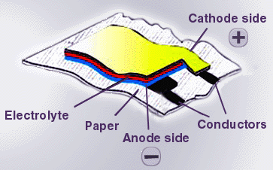
Applications: Energy Industry
Transistors
Electrical Cables
Power/Data Transmission
Paper Batteries
Cellulose infused w/CNTs
that function as anodes
Photovoltaic Cells
Experimentally observed to
increase efficiency up to 8.5% due to UV absorption qualities

Slide 13
Applications: Water Treatment
Boron-doped MWNT nano-sponges can absorb oil from water
Superhydrophobic: remains at water surface
Oleophilic: draws oil to it
Easy to retrieve due to magnetic properties
Desalination
Water molecules separated from salt by passing through nanotube networks
Requires lower pressure than reverse osmosis

Slide 14

Applications: Future Space Elevator?

Slide 15
Conclusion
CNTs are cylindrical arrangements of graphene sheets
CNTs have excellent strength, thermal and electrical conductivity, and low density due to their sp²-hybridized C bonds
CNTs have the potential to improve many fields and industries
Diverse applications, from energy storage to environmental cleanup

Slide 16
References
"Beyond batteries: Storing power in a sheet of paper.” EurekAlert! Science News. 13 Aug. 2007. Web. 07 Feb. 2016.
Callister, William D. Fundamentals of Materials Science and Engineering: An Integrated Approach. 4th ed. Hoboken, NJ: John Wiley & Sons, 2005. Print.
Gethard, Ken, et al. “Water Desalination Using Carbon- Nanotube-Enhanced Membrane Distillation.” ACS Applied Materials & Interfaces, 2011; 3 (2): 110 . Web. 7 Feb 2016.
Guo, Ting, et al. "Self- Assembly of Tubular Fullerenes." The Journal of Physical Chemistry. 99.27 (1995). Web. 6 Feb 2016.

Slide 17
References
Janas, Dawid, et al (February 22, 2014). "Iodine monochloride as a powerful enhancer of electrical conductivity of carbon nanotube wires". Carbon 73: 225–233. Web. 7 Feb 2016.
Naha, Sayangdev, and Ishwar K. Puri (2008). "A model for catalytic growth of carbon nanotubes". Journal of Physics D: Applied Physics 41 (6): 065304. Web. 7 Feb 2016.
Smiljanic, Olivier; et al (22 April 2002). “Gas-phase synthesis of SWNT by an atmospheric pressure plasma jet.” Chemical Physics Letters 356 (3-4): 189-193. Web. 6 Feb 2016.

